Slide 1
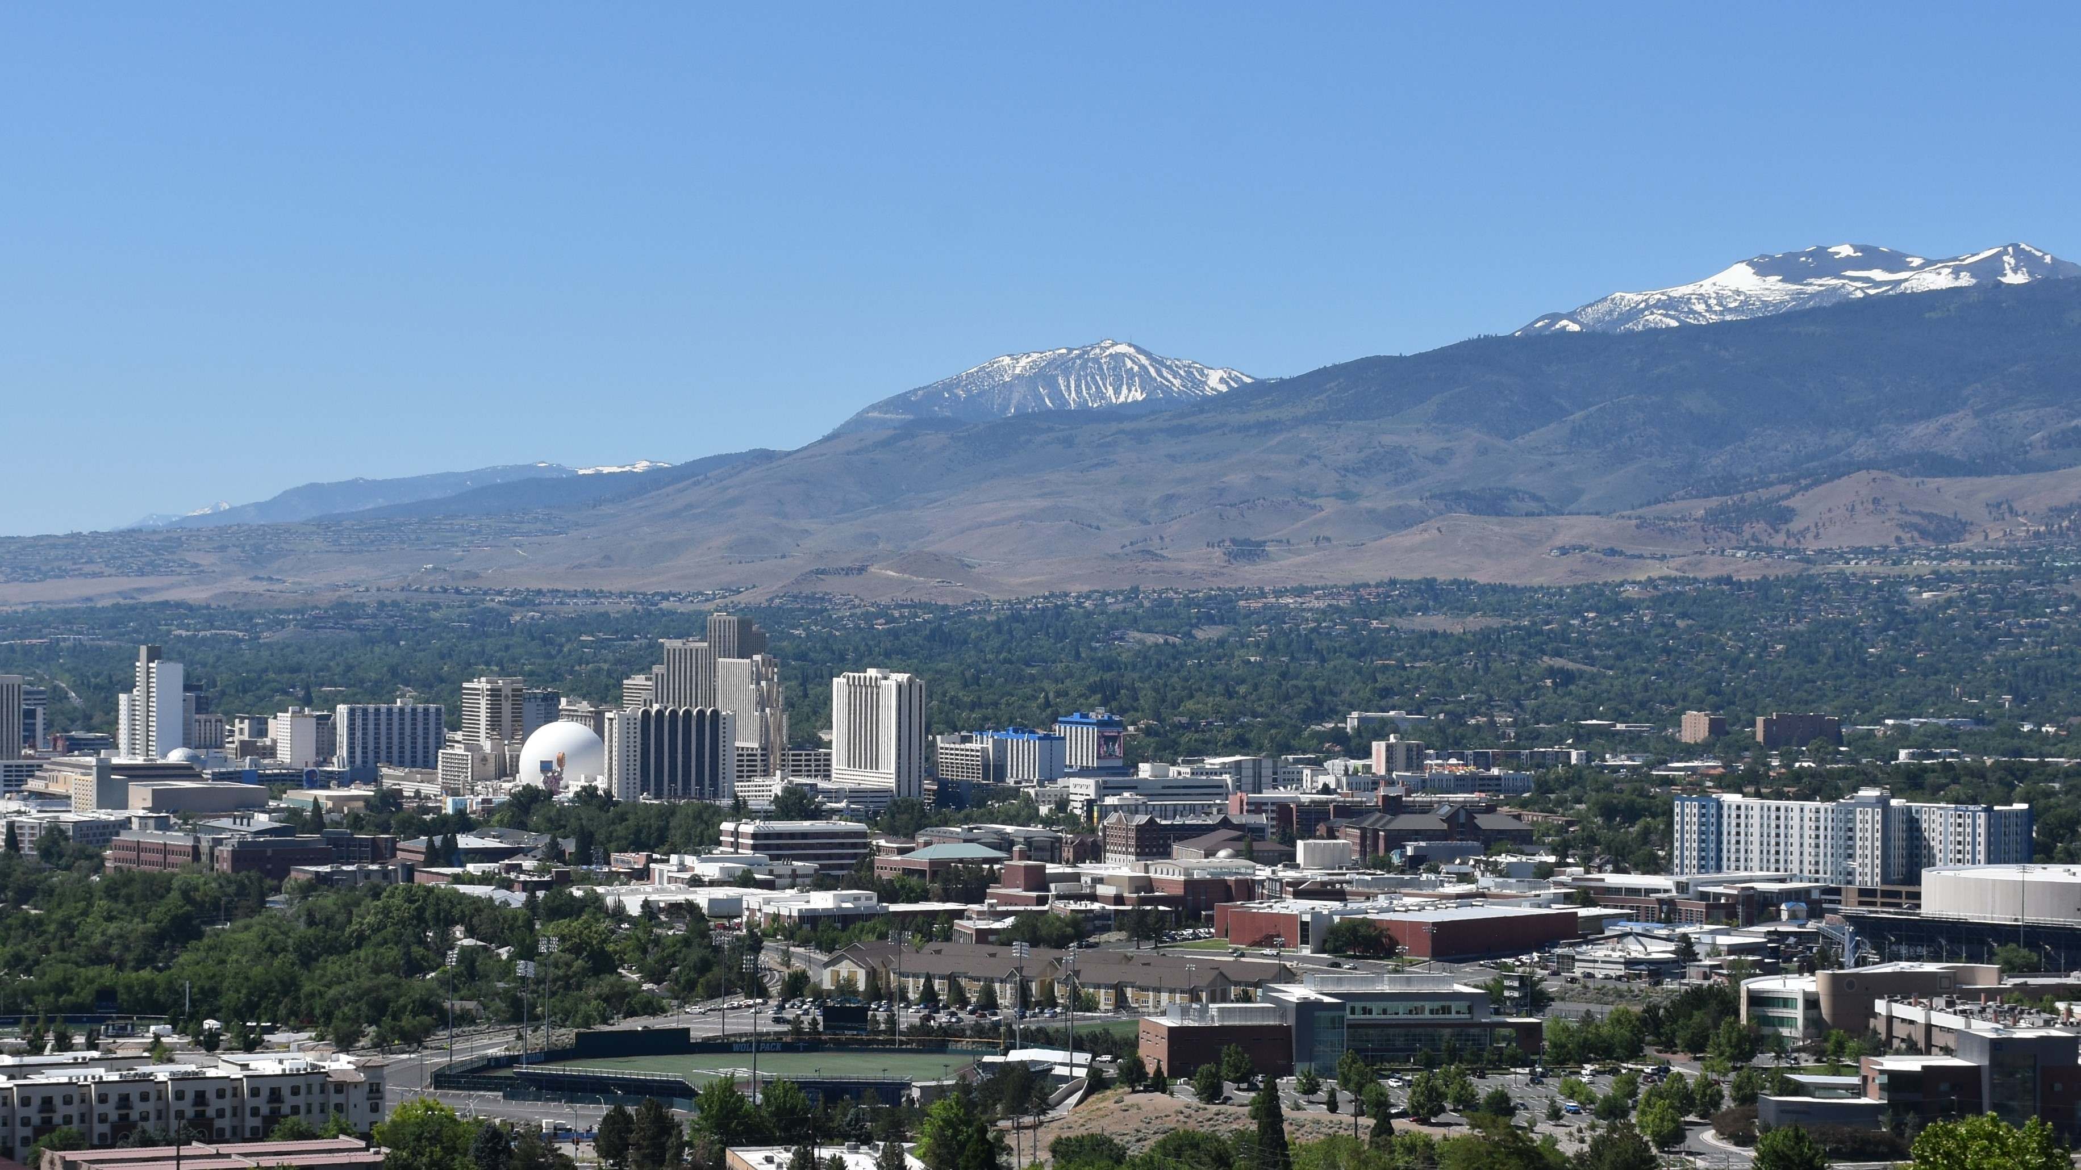
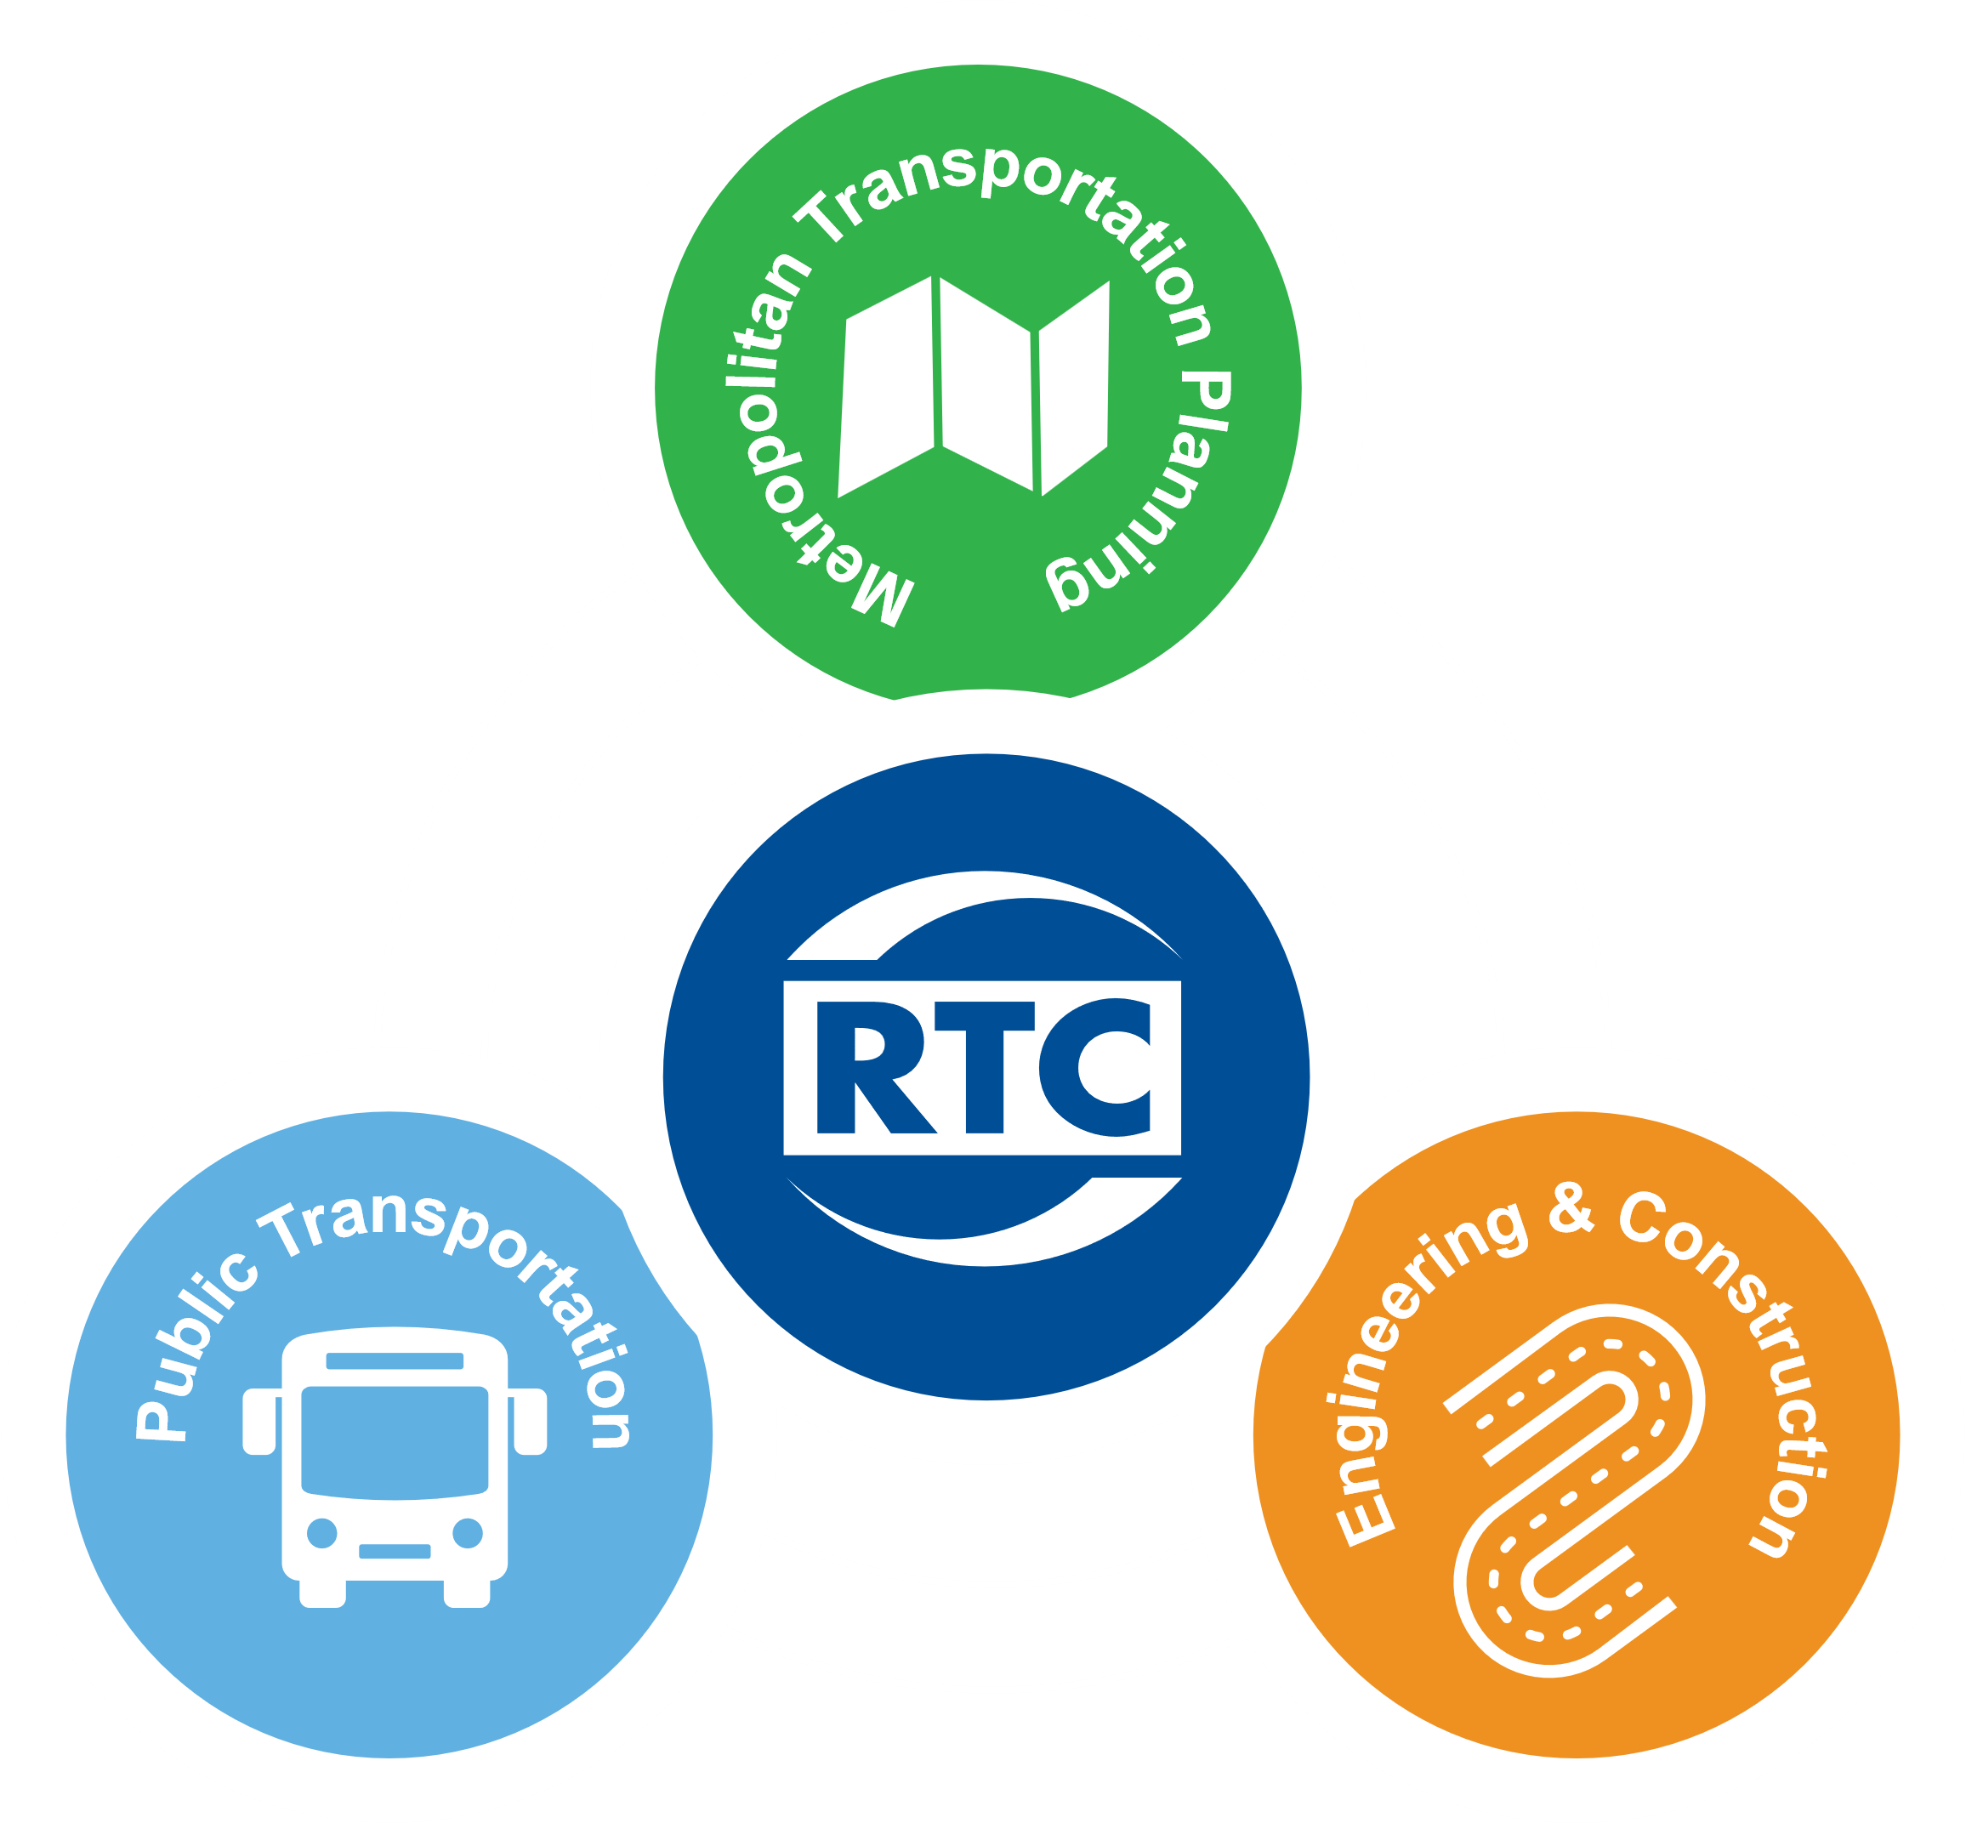
RTC WASHOE UPDATE
May 13, 2025

Slide 2
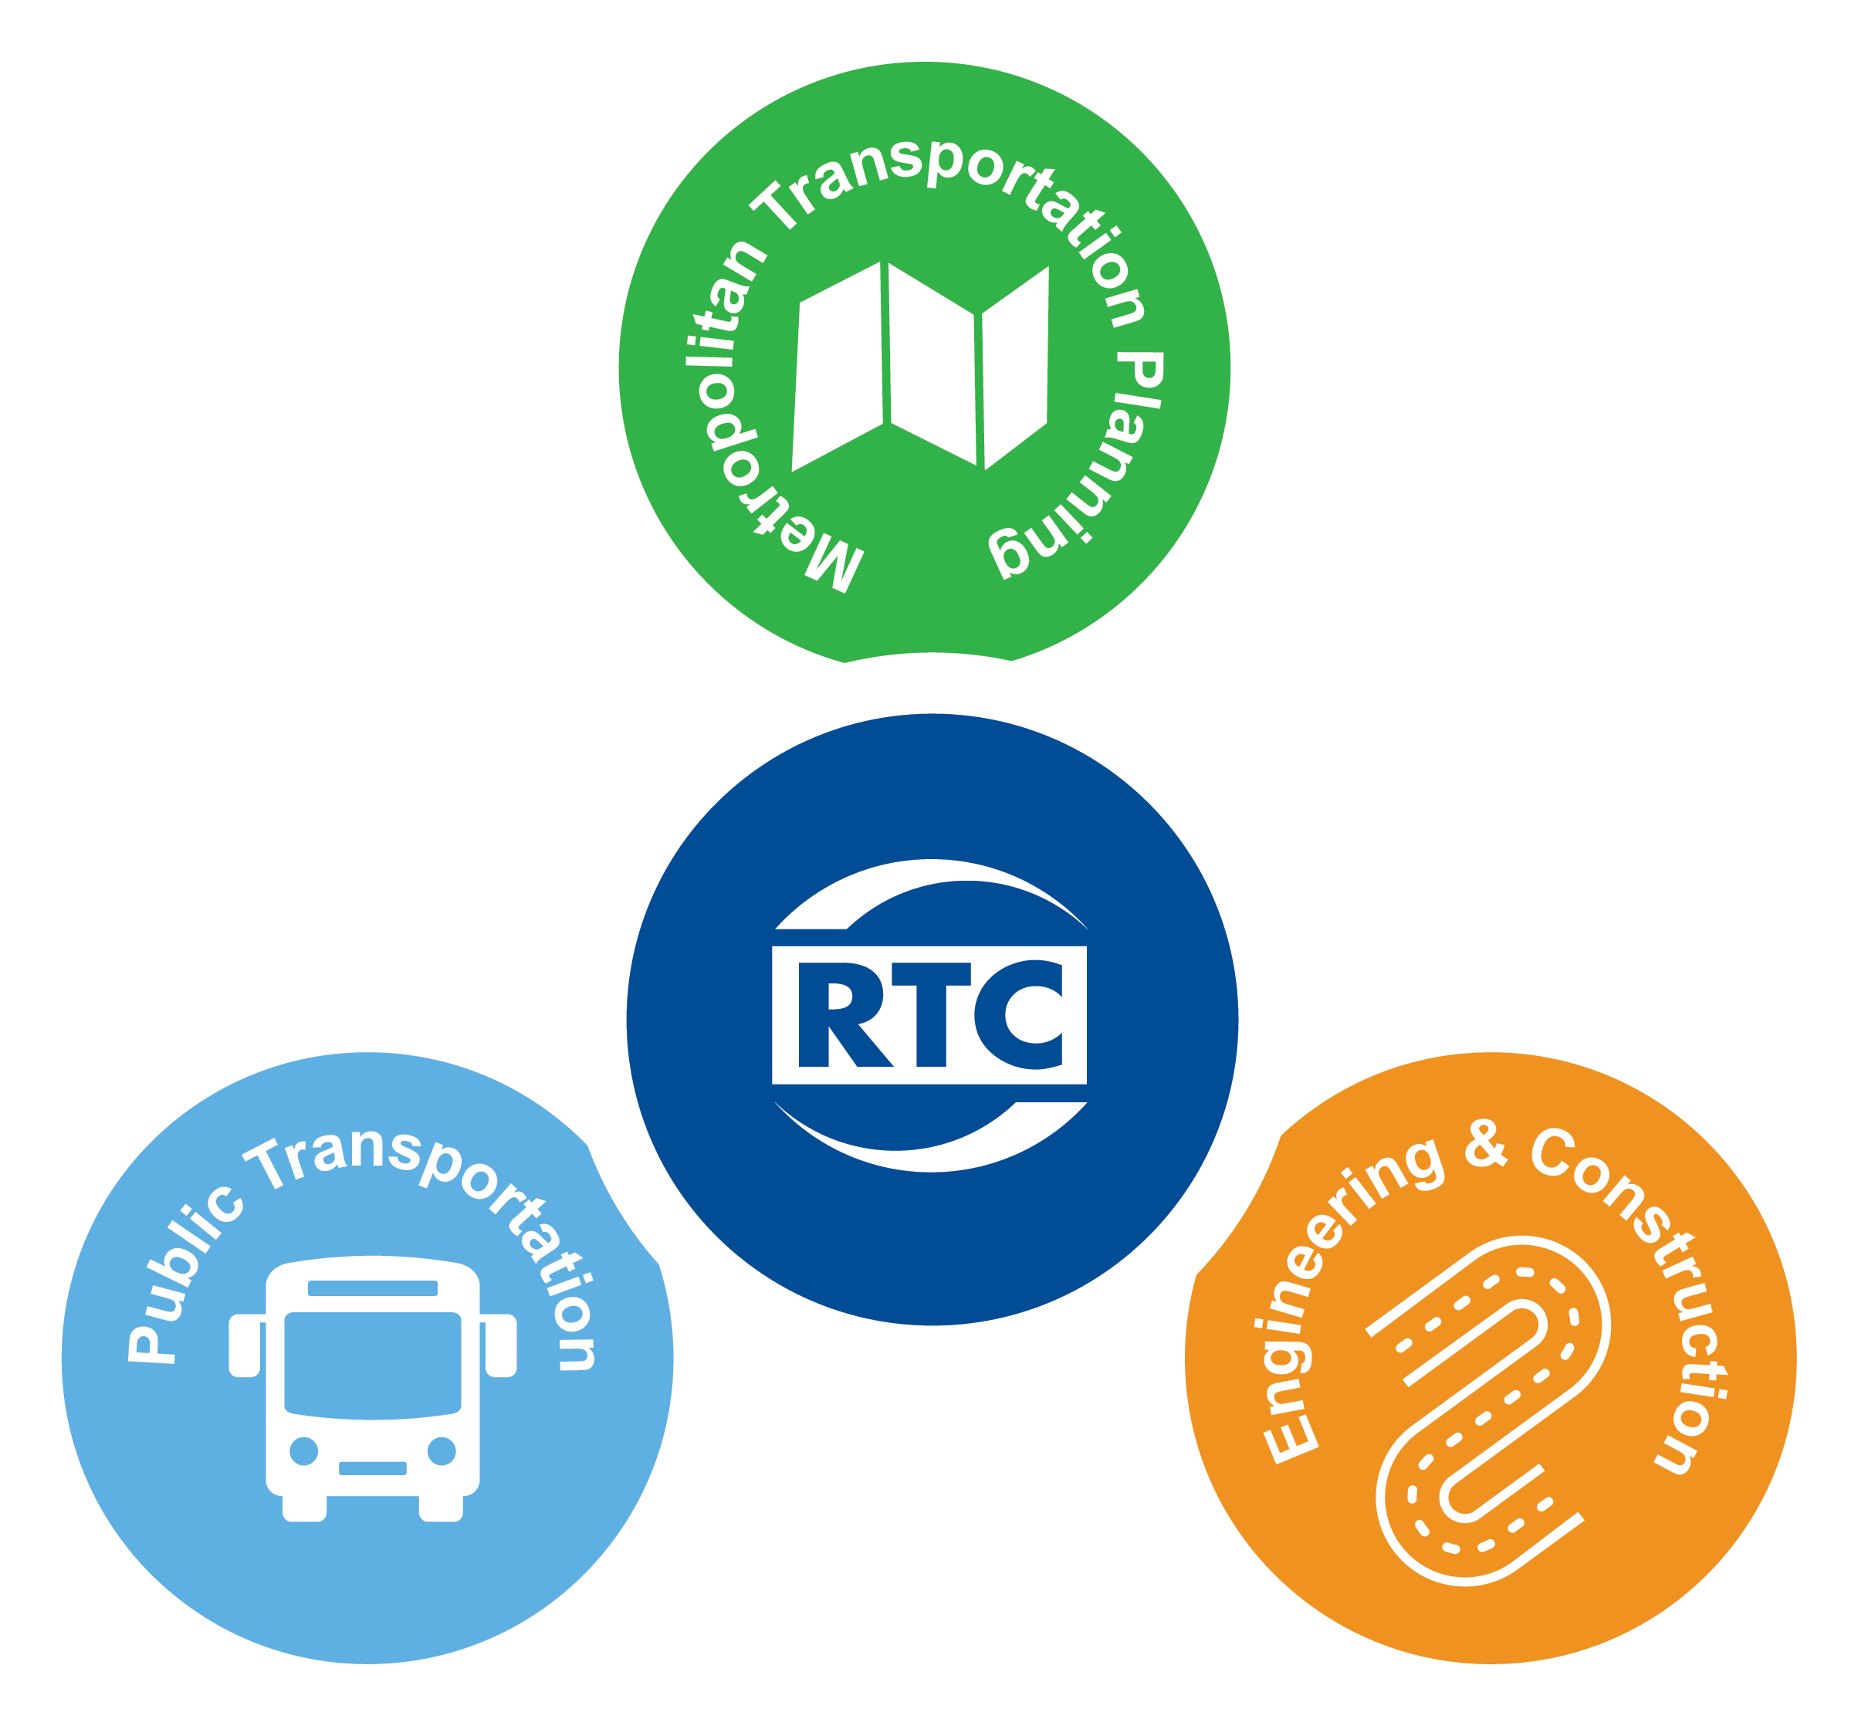
> MISSION
> CORE FUNCTIONS
Building A Better
Community Through
Quality Transportation

Slide 3

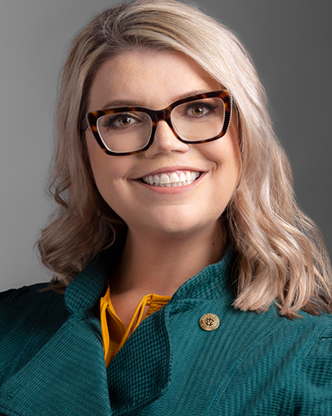
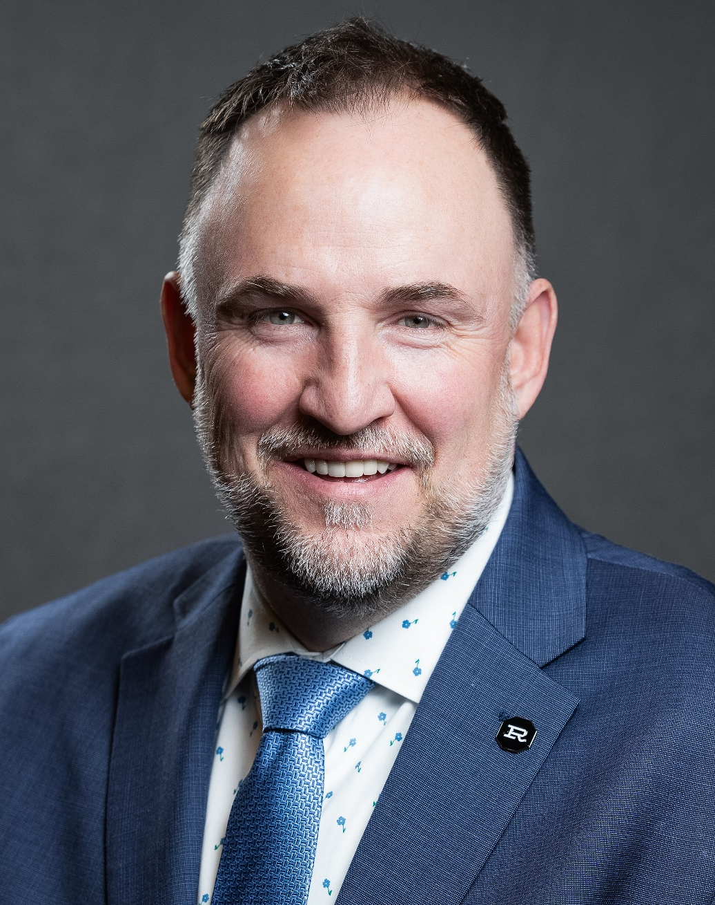
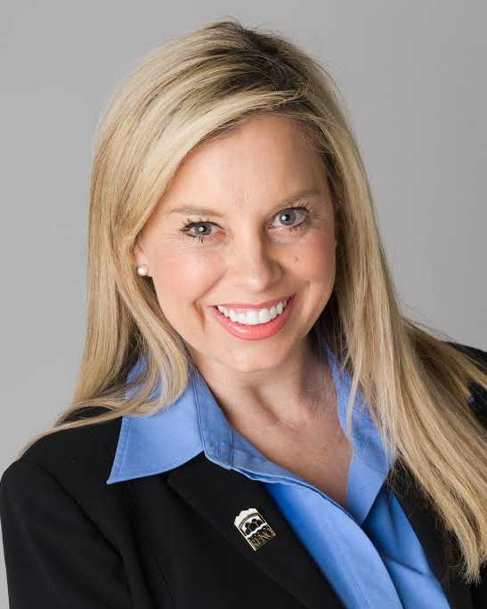
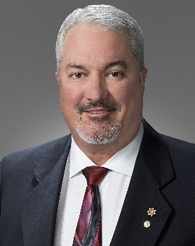
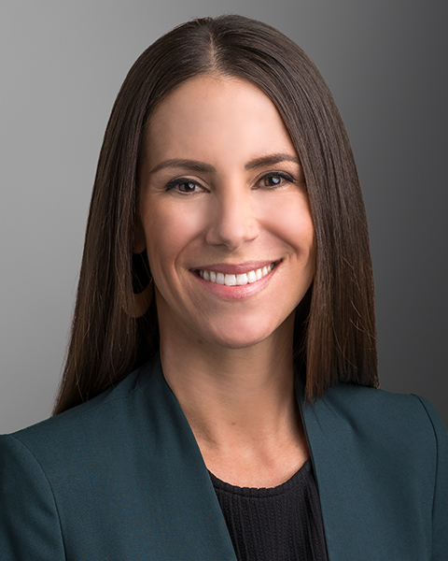
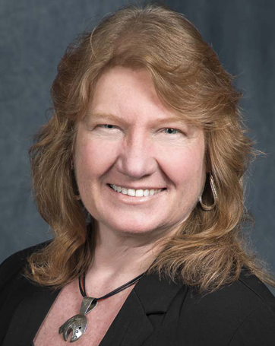
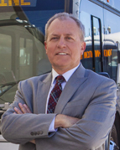

> RTC BOARD OF COMMISSIONERS
RTC Vice Chair
Commissioner
Commissioner
Commissioner
Alexis Hill
Washoe County
Devon Reese
City of Reno
Hillary Schieve
Mayor of Reno
Ed Lawson
Mayor of Sparks
Mariluz Garcia
Washoe County
Ex Officio
RTC
Tracy Larkin Thomason
NDOT
Executive Director
Bill Thomas, AICP

Slide 4
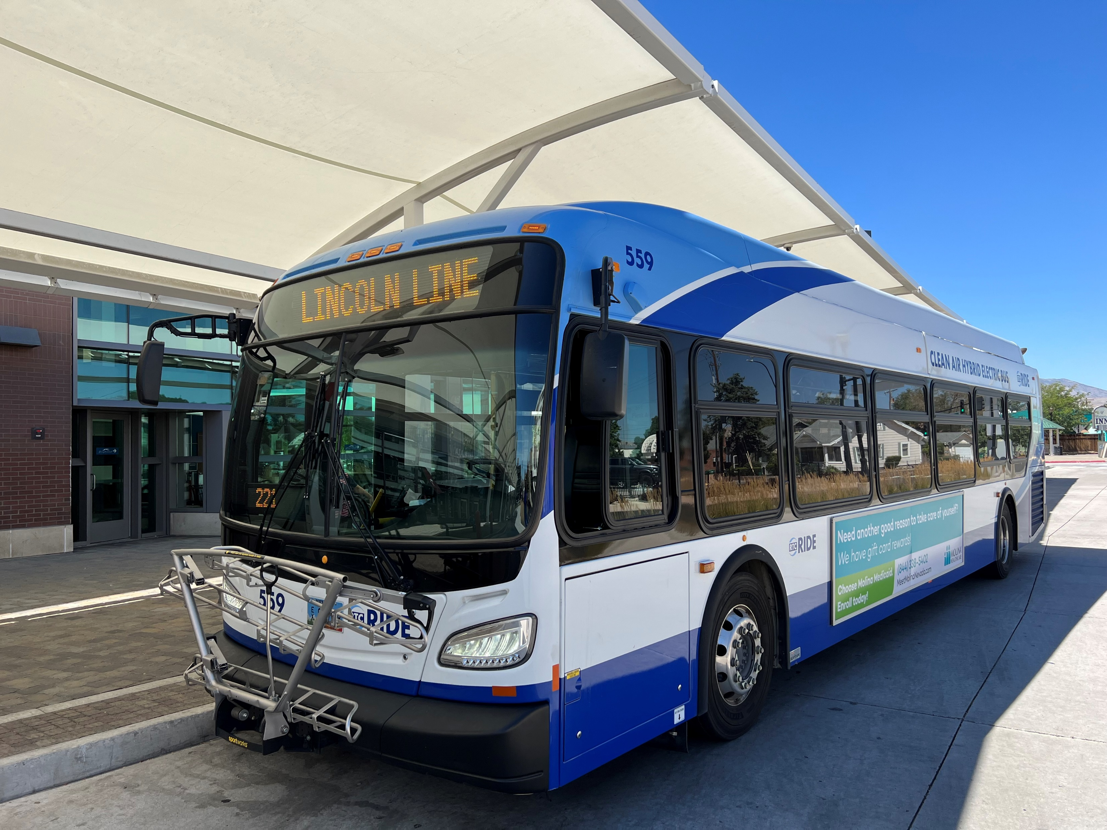
> PUBLIC TRANSPORTATION
Fixed Route Transit
RTC RIDE
Backbone of the Transit System
Last 12 Months: 5.72 Million Trips
60% Work Trips
32 Straight Months of Ridership Growth
All-Electric, Diesel-Electric Hybrid, Hydrogen Fuel Cell

Slide 5
> REVENUES
Fiscal Year 2026 Budget
Fuel Tax (41%)
Sales Tax (15%)
Federal Funding (36%)
Passenger Fees (1.4%)
NDOT (.4%)
Other (6.7%)

Slide 6
> EXPENDITURES
Fiscal Year 2026 Budget
Transit (36.9%)
New Roadway Projects (38.1%)
Preservation & Multimodal Projects (16.4%)
Debt Service (7%)
MPO-Operating (1.6%)

Slide 7
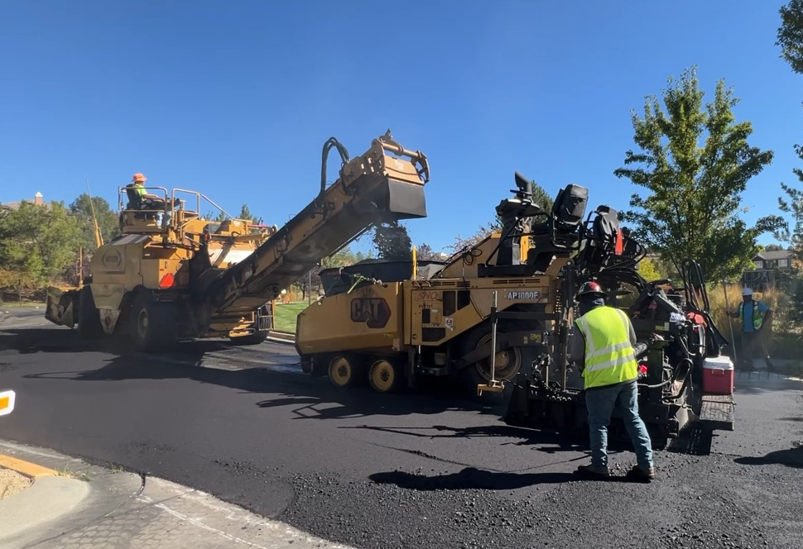
> REVENUE FROM INDEXING – RTC WASHOE
Total Revenue Collections Since Inception: $1.32 Billion
Indexing Revenue Since Inception: $799 Million
Base Rate Collections Since Inception: $521 Million
Percentage of Revenue from Indexing: 60.5%

Slide 8
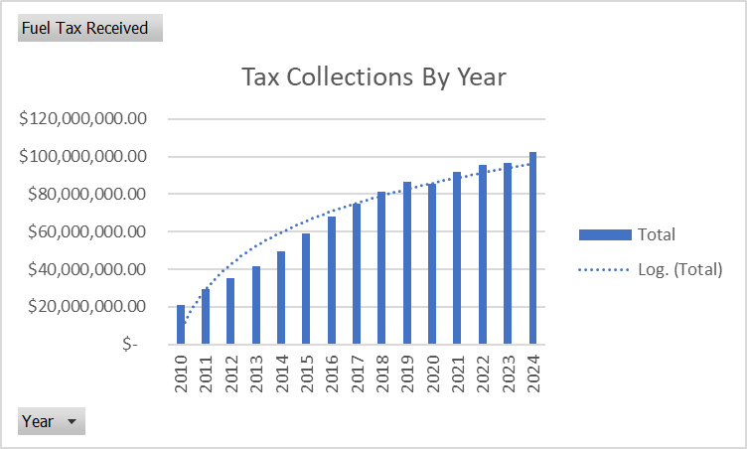
> REVENUE IMPACTS

Slide 9
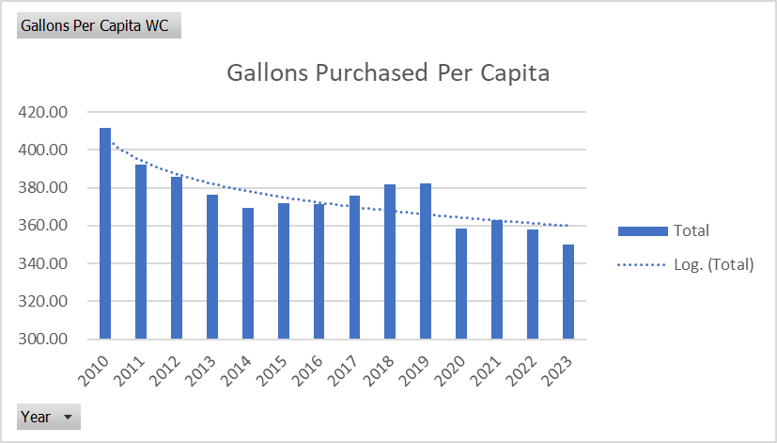
> GALLONS PER PERSON

Slide 10
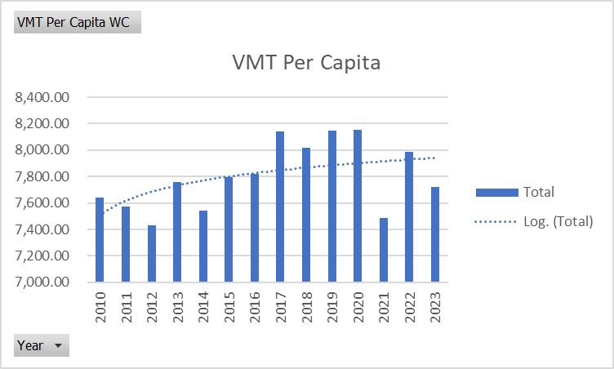
> VMT PER PERSON

Slide 11
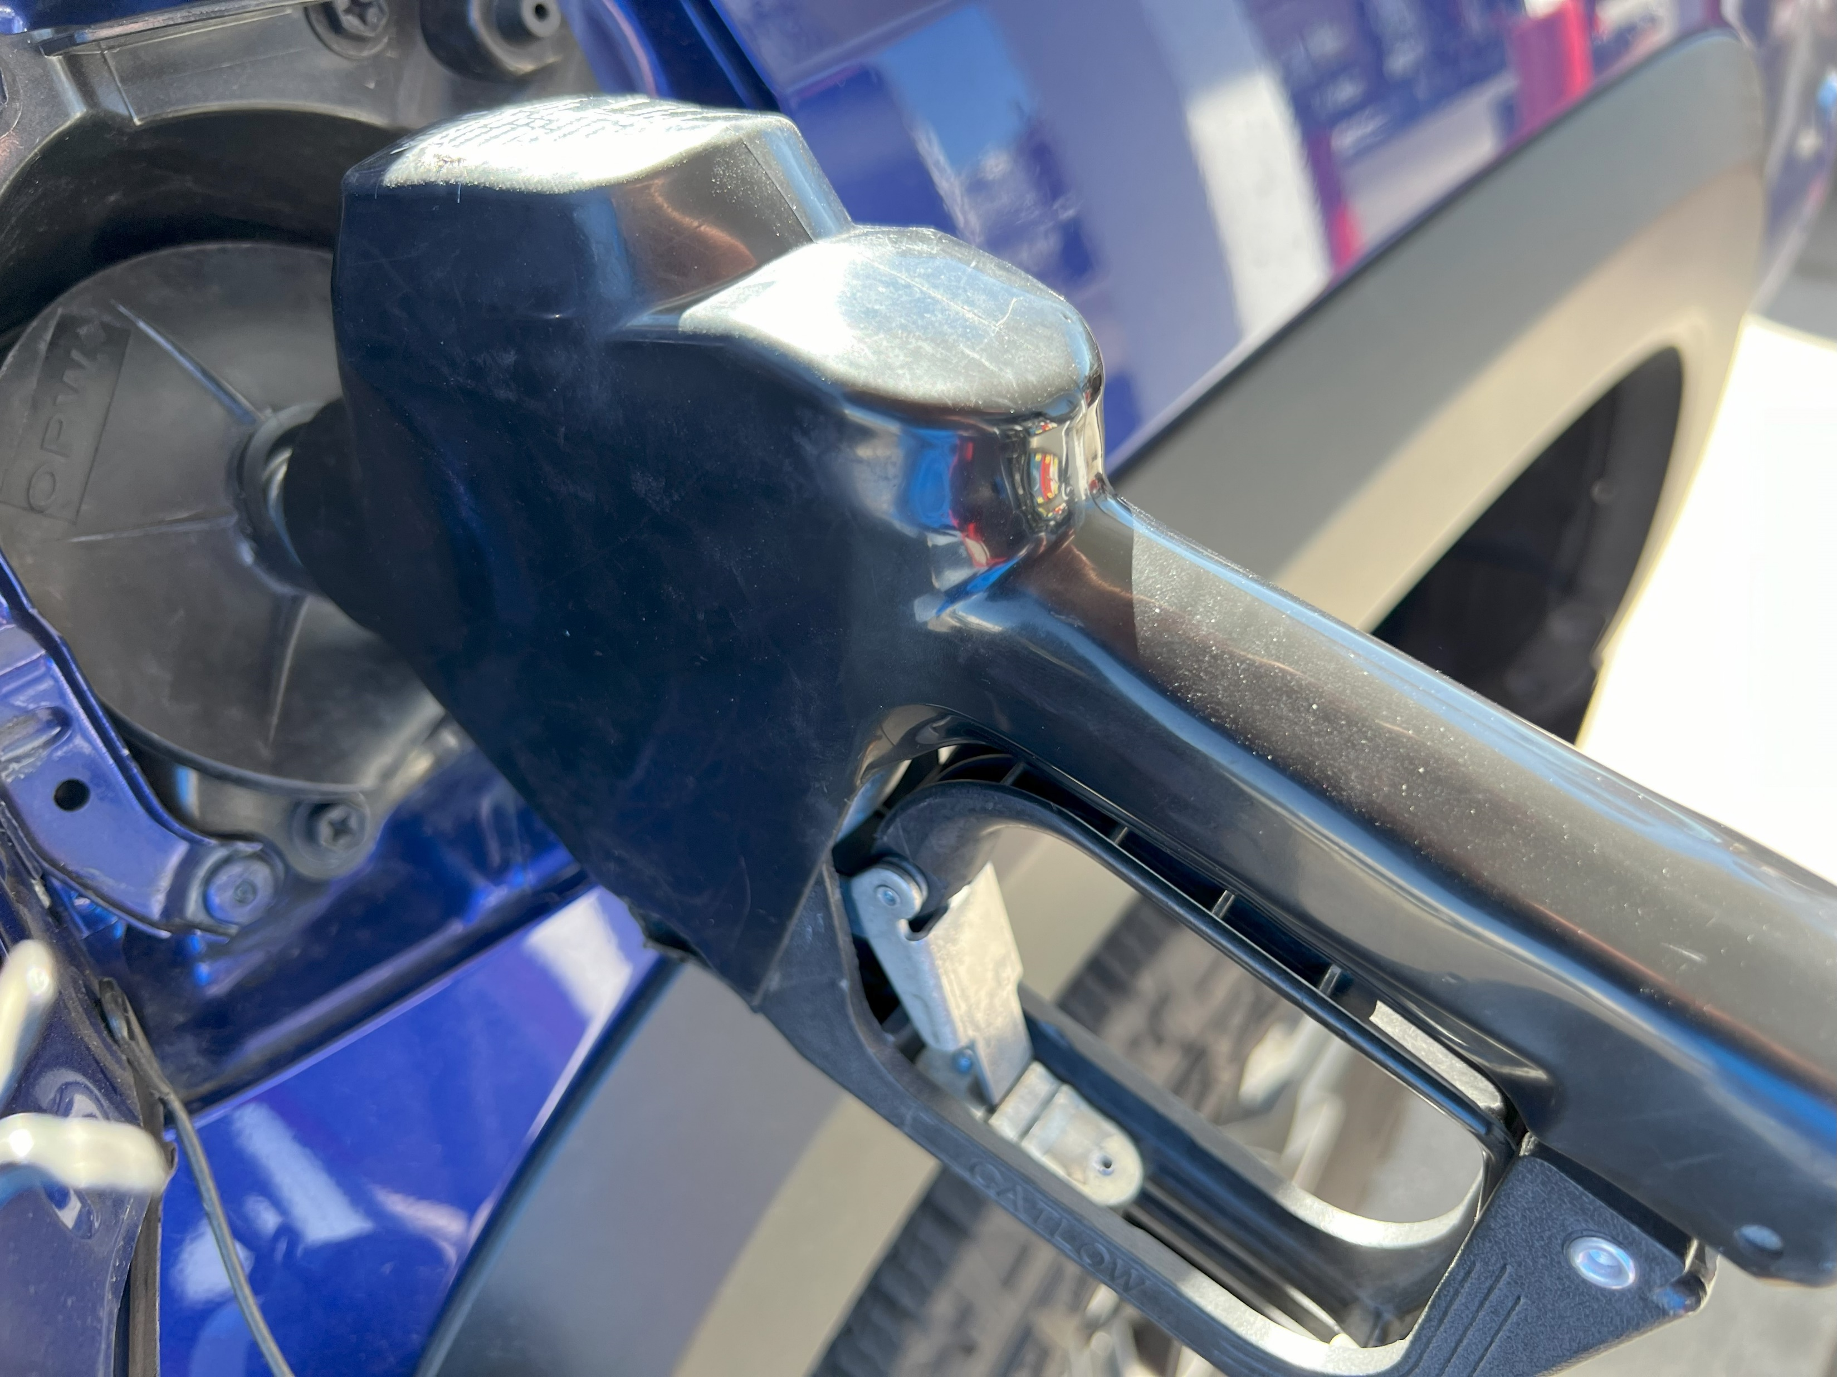
> FUEL REVENUE INDEXING RTC SNV
Clark County’s ability to fund road projects
Could relieve financial burden on NDOT
Impact on state funding for Washoe County

Slide 12
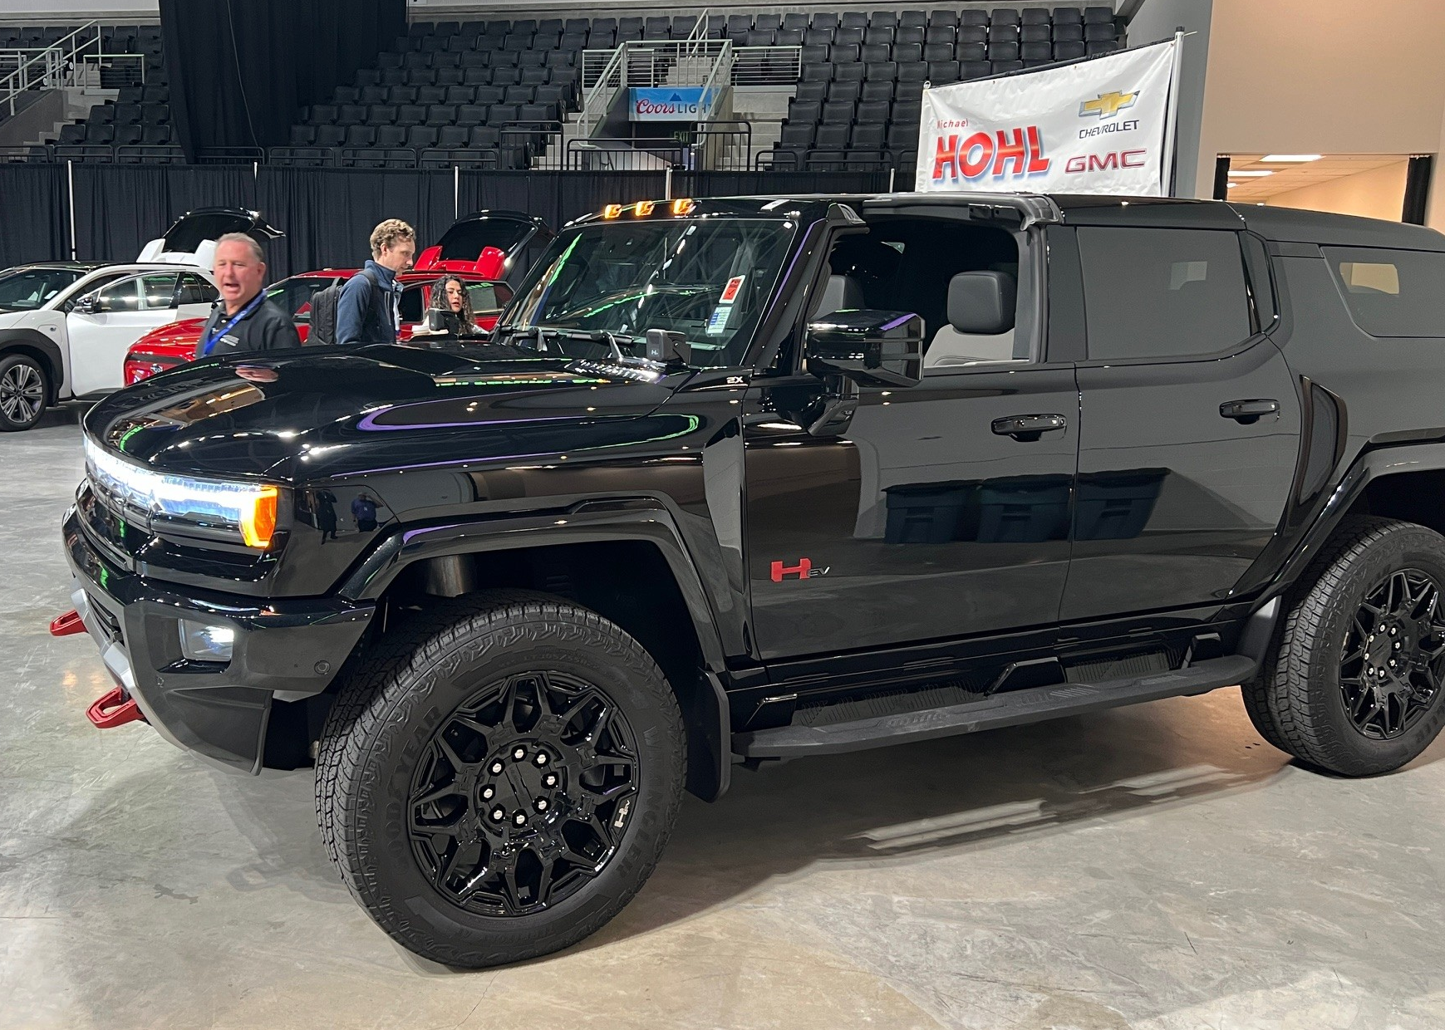
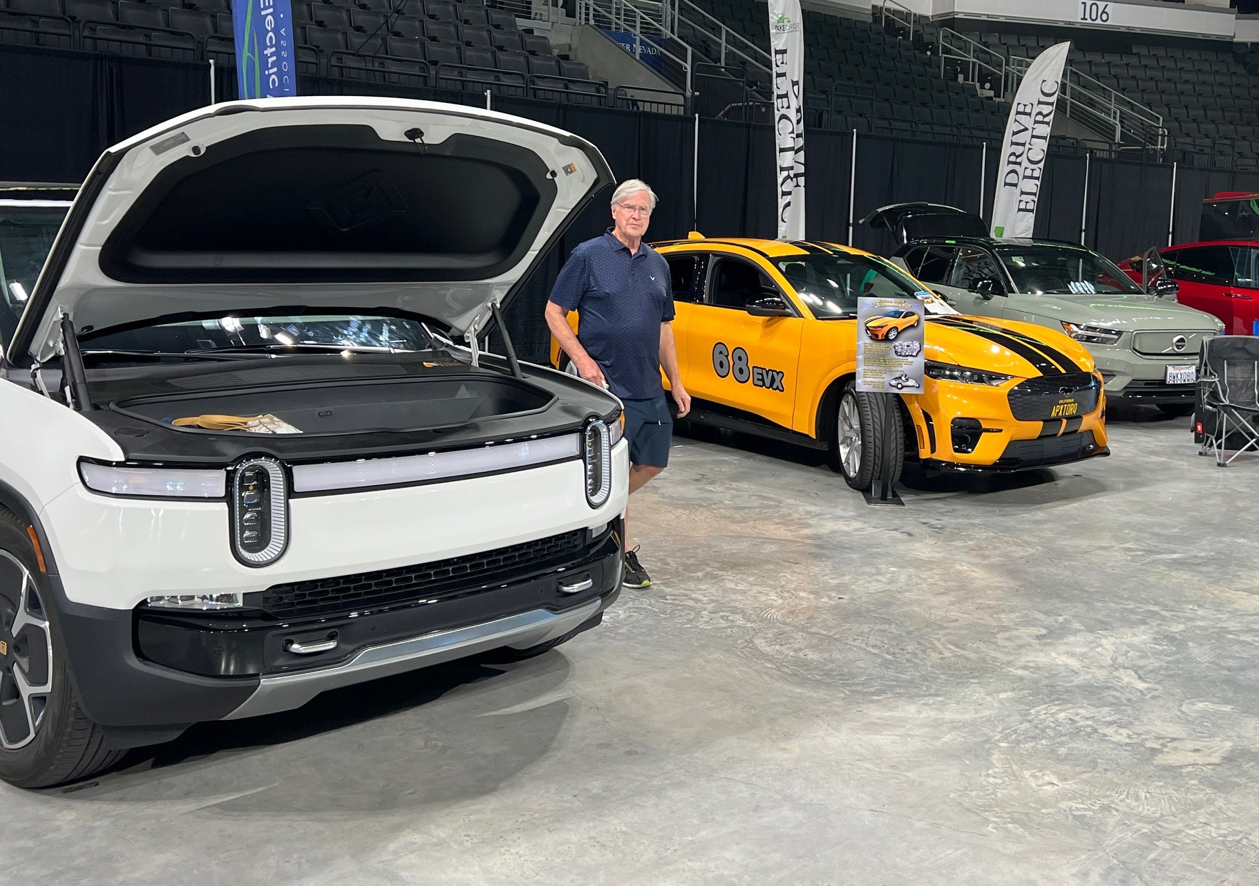
> ELECTRIC VEHICLE PARITY
Flat fee for EV and hybrid vehicles
Potential for each county to approve additional fee to correspond with local fuel tax
Funding would go toward road improvements

Slide 13
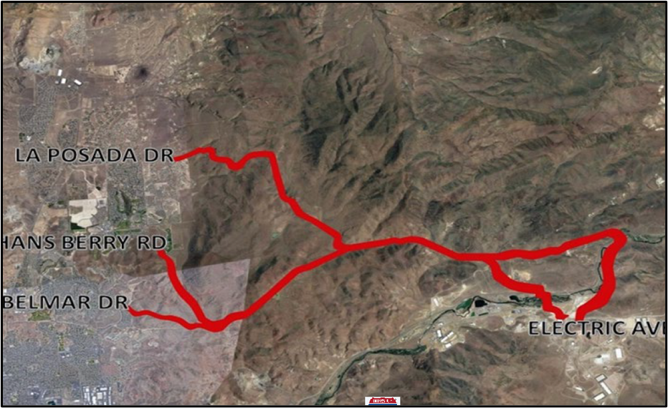
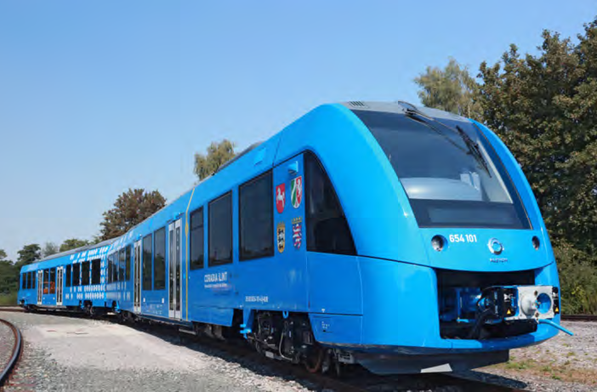
> TRANSPORTATION EXPANSION TO TRIC
Alternate Routes
  La Posada to USA Parkway
  South Meadows Parkway to USA Parkway
Commuter Rail
Interstate 80 Widening
Possible Funding
  Federal Grants
  Public/Private
  Tolling (AB61)

Slide 14
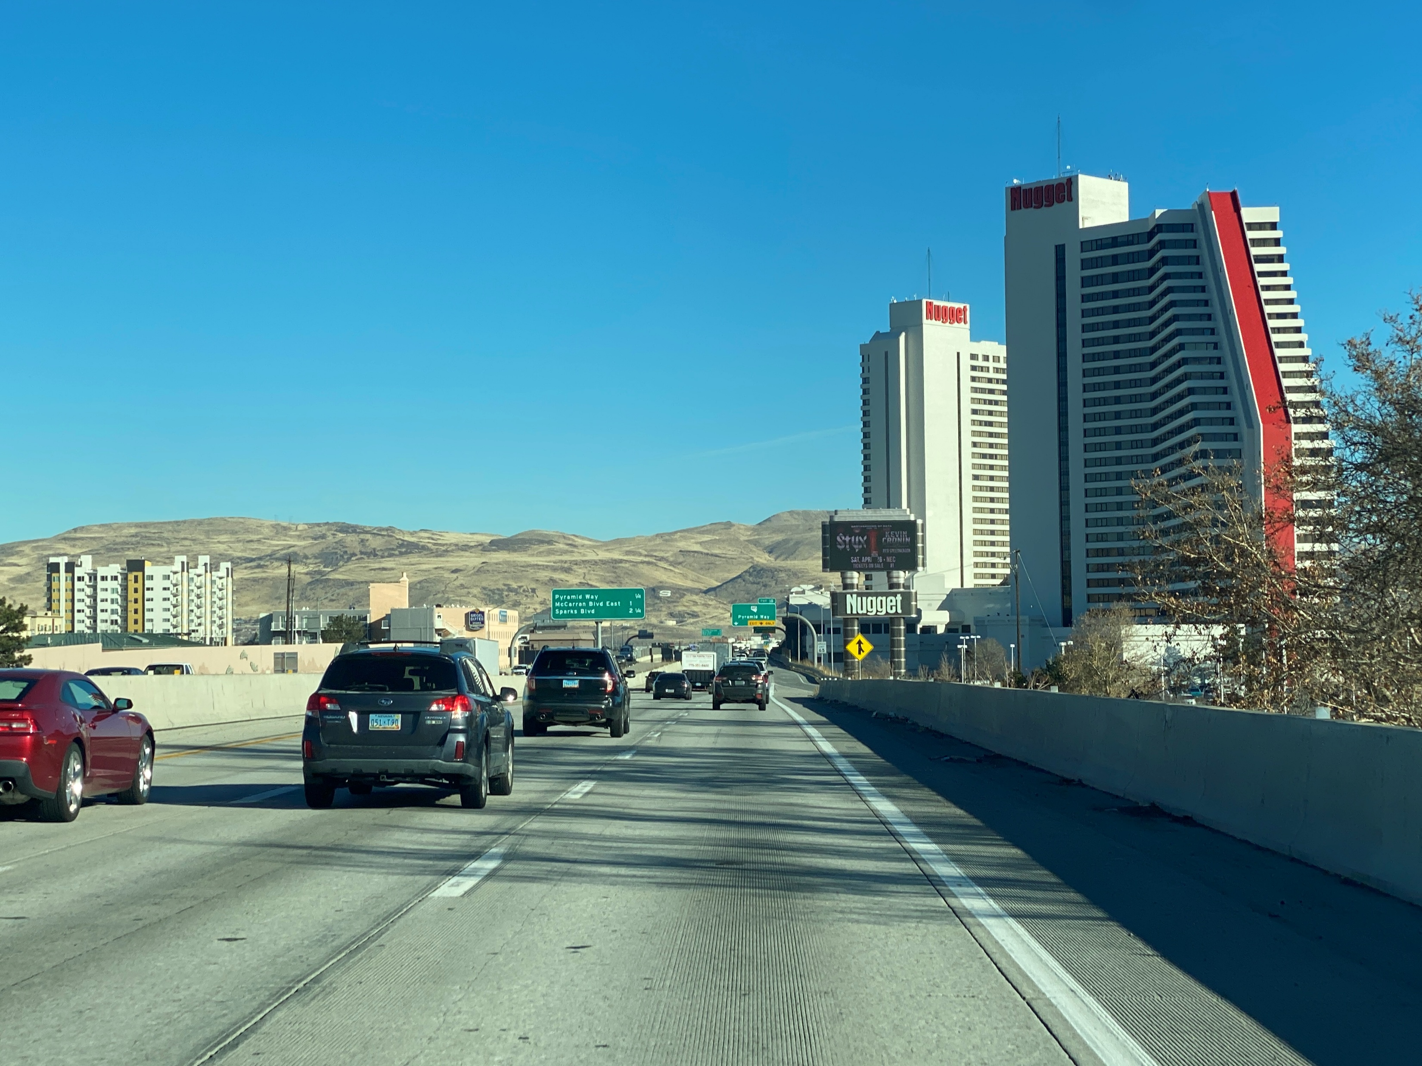
> SPAGHETTI BOWL FUNDING
Phase 1 - Complete
Phase 2 - I-80 from Spaghetti Bowl to East McCarran
Phase 3 – U.S. 395 from Spaghetti Bowl to North McCarran Boulevard (east side)
Phase 4 – I-580 from Spaghetti Bowl to Moana Lane
Phase 5 – U.S. 395 from North McCarran Boulevard to Spaghetti Bowl (west side)

Slide 15
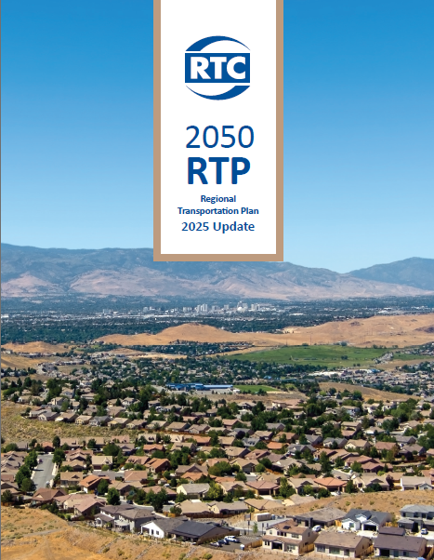
> PLANNING
2050 Regional Transportation Plan Update
Key Findings From Community Feedback
Transportation Challenges
  Traffic Congestion and Delays
  Unsafe Driving Conditions and Behaviors

Slide 16

THANK YOU
Building A Better Community
Through Quality Transportation
rtcwashoe.com

